Slide 1
INTRODUCTION
To
MAISEL SudParis
Yvon ESCOBAR
Président de la MAISEL SudParis
Christine GONZALEZ,
Directrice de la MAISEL SudParis
Magali LE PORHIEL,
Assistante de Gestion

Slide 2
INTRODUCTION PLAN
Organisation
Practical informations
Life in the Maisel

Slide 3
1- Organisation
STATUS & MISSIONS
Association law1901
Offers accommodation to most students IMT-BS and TSP on or near campus
Support members in their administrative procedures
Participates in the development of associative life within the campuss

Slide 4
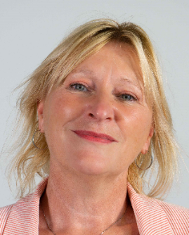
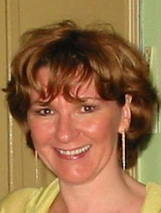
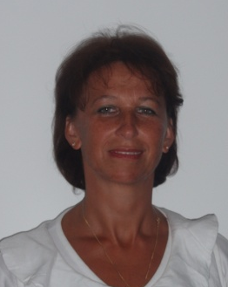
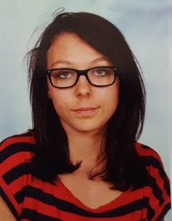
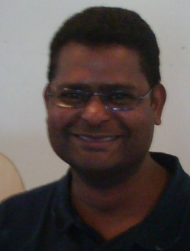
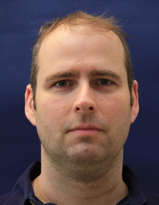
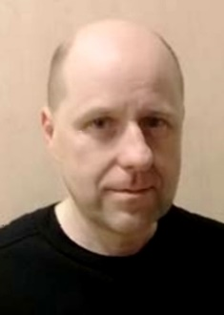
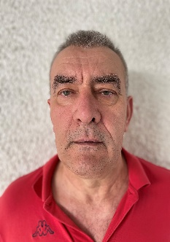
administrative and financial matters
1- Organisation
Who’s who ?
Notre équipe
Director
Equipe Administrative
Christine Gonzalez
Christine Fixot Magali Le Porhiel Elisa Muzzin
Accomodation Administrative and financial matters
President
Technical Team
Yvon Escobar
Noel Taily Patrick Sallé Franck Zemmour Meder Marc Ioan TURDA
Technical Manager

Slide 5
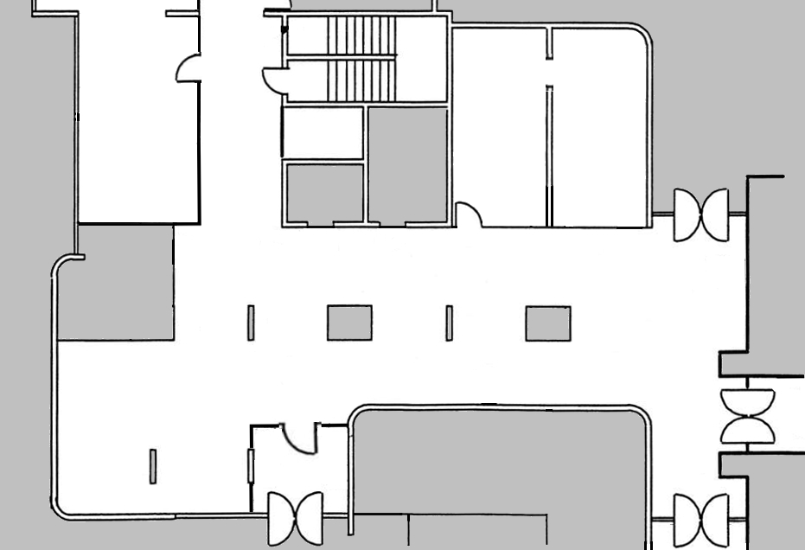
2- Practical information
Maisel Desk
Maisel office
OPENING HOURS
Monday to Thursday 1:30pm to 5:30pm
on Friday 1:30pm to 4:30pm
CLOSED on Wednesday
Administrative documents, cash payments, financial questions
Meeting the Director
OPENING HOURS
Monday to Thursday 1:30pm to 5:30pm
on Friday 1:30pm to 4:30pm
General requests
Ground floor building U2
5, rue Charles Fourier

Slide 6
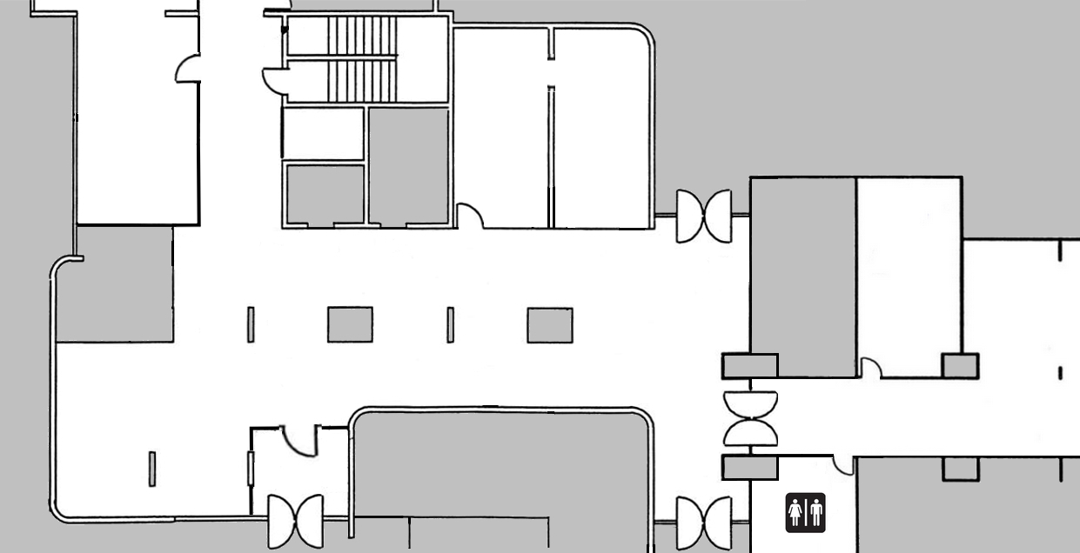
2- Practical Information
Maisel desk
Maisel technician on duty
Monday to Friday 7:00am to 8:30pm
Technical questions, Maisel card issue
Maisel office
Technical office
Ground floor building U2
Ground floor building U1
5, rue Charles Fourier

Slide 7
2- Practical Information
WHERE TO FIND INFORMATION
MAISEL WEBSITE http://maisel.imtbs-tsp.eu
most important pages : The Association / Maisel Charter
Accommodation / Housing fees, Housing subsidies
MAISEL essentials / Practical information
DOCUMENTS GIVEN IN YOUR MAISEL FOLDER UPON CHECK IN
Maisel resident summary guide, welcome note
MAISEL EMAILS are « first class » mails ! Make sure to receive them, read them carefully
MAISEL Channel of ecampus (Digital workspace of IMT-BS & TSP)
CAF guideline, electronic lock instructions of use…
USEFULL HINTS SHEET DISPLAYED AT THE BACK OF YOUR ROOM DOOR
DISPLAY BOARDS IN THE HALL OF THE MAISEL BUILDINGS

Slide 8
2- Practical Information
EMERGENCIES: In case of safety or security hazard only
(flooding, fire hazard, unusual disturbances…)
=> Dial 01 60 76 40 71 (Technician on duty 24 hours a day)
Should you loose or forget your swipe card/keys, no technical service past 10:00pm
there is no keeper in the Maisel
TECHNICAL PROBLEMS :
=> Send an email to : entretien-maisel@imtbs-tsp.eu
The technician on duty can be met at the Technical office from 7:00pm to 8:30pm

Slide 9
SECURITY
3- Vie à la Maisel
For your safety, all buildings MAISEL
are under video surveillance
Notes:
J’aborde maintenant quelques points concernant la sécurité
Un badge est indispensable pour pénétrer dans les bâtiments de la Maisel, ne laissez pas n’importe qui pénétrer en même temps que vous, il en va de votre sécurité et de celle des autres ! Ne prêtez pas votre badge, et à plus forte raison si votre logement est équipé d’une serrure électronique…

Slide 10
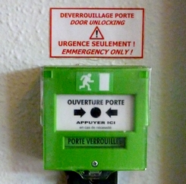
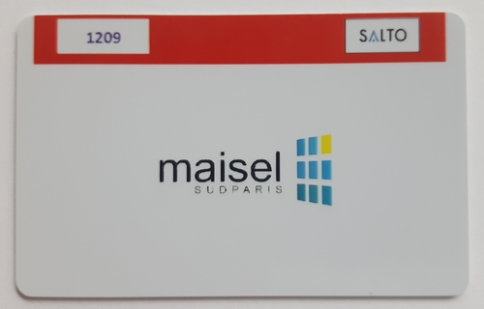
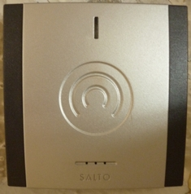
SECURITY
3 - Life in the Maisel
EXCEPT IN AN EMERGENCY EVACUATION :
NEVER use the emergency control devices
To unlock the access doors (green boxes)
ALWAYS USE YOUR MAISEL CARD !
(or the pushbutton -if any- to open the door )
- Do NOT USE the emergency exits, they must be always closed

Slide 11
SECURITY
3 - Life in the Maisel
Common sense tips :
Make sure that your room door is always locked (even if you are inside)
INSURANCE COMPANIES NEVER REIMBURSE IN CASE OF BURGLARIES WITHOUT
BREAKING AND ENTERING
- Do not allow unknown people to get in the Maisel buildings with you
- Should you suspect any strange activity or behaviour, call the Maisel technician on duty immediatly (dial 01 60 76 40 71)

Slide 12
ESSENTIAL RULES
3 - Life in the Maisel
- Take care of the equipments at your disposal
- Clean your room !
- Do not change your room arrangement (furnishing, equipement)
- Do not use forbidden devices (refer to the Maisel charter or ask the technical staff)
- No parties in your room ! (book a common room to organize a private event)
- No squatters !... (Maisel rooms and studios are individual)
- Do not sublease your room (strictly forbidden)
- Respect each others’s sleep and privacy (no night disturbance !)
As a summary : respect the Maisel charter !

